Slide 1



14 days of learning challenge
with
Featurepreneur

Slide 2
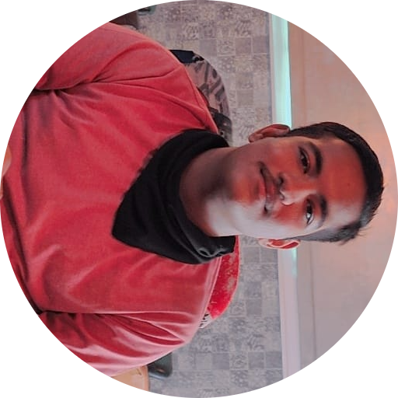
Who am I?
Engineering junior in Electronics and Communication
Opensource Enthusiast
Tech Communities
Upcoming Devrel at [ ¯\_(ツ)_/¯ ]
Himanshu

Slide 3

Before featurethon
negligible knowledge about ML

Slide 4
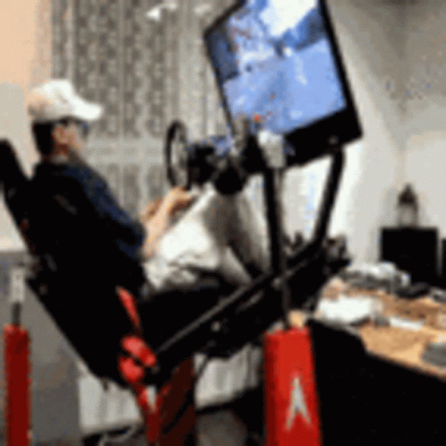
My project idea
implement neural search to make a search engine for gamers
Search game by its name/rating/platform/genre

Slide 5

Jina AI!
Made things lot more easier
Awesome Documentation

Slide 6
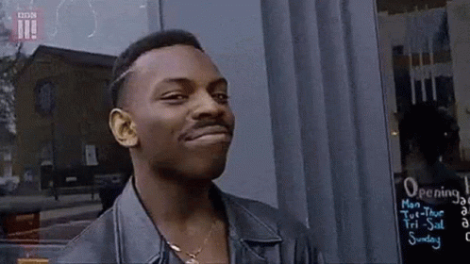
Fundamentals
Document:- basic data type,
Executor:- it processes the documents
Flow:- combine all executors

Slide 7
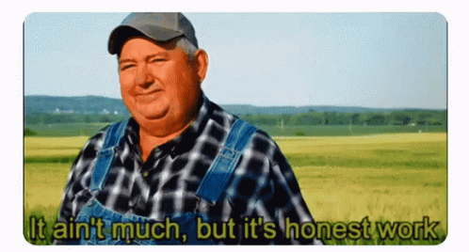
My progress so far
Created a MVP of project
Need to work on the flow execution

Slide 8

Learnings
Neural search
basics of jina
Keyboard shortcuts for jupyter notebook
concept of pooling
encoding and indexing
basics of ml

Slide 9

Shortcomings :(
going solo
Offline classes

Slide 10

My amigos!
Jina docs/ youtube /slack
Jaabir and Abhishek 🙂

Slide 11
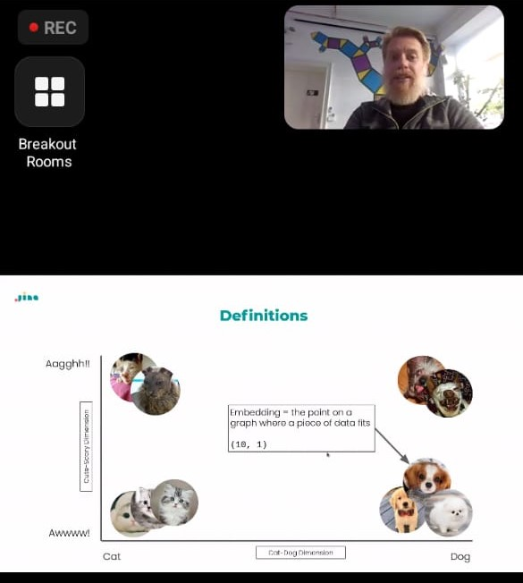
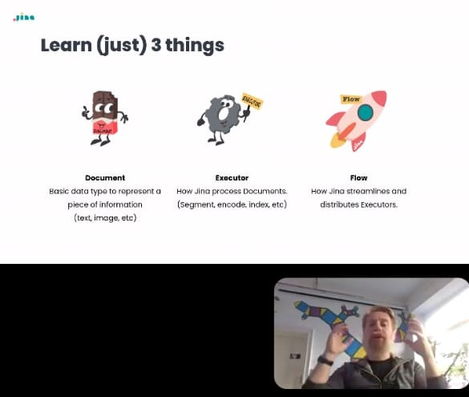
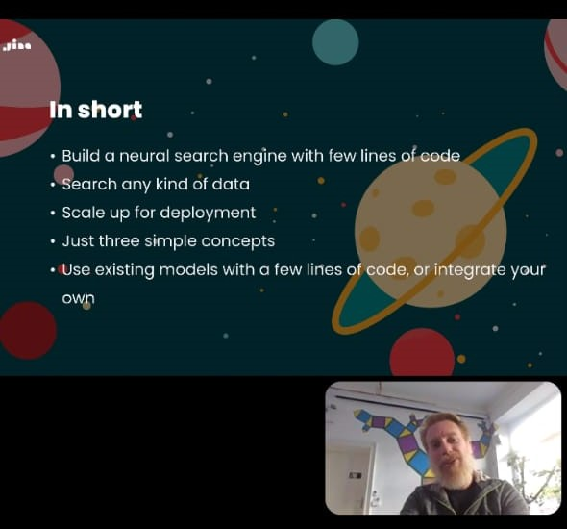
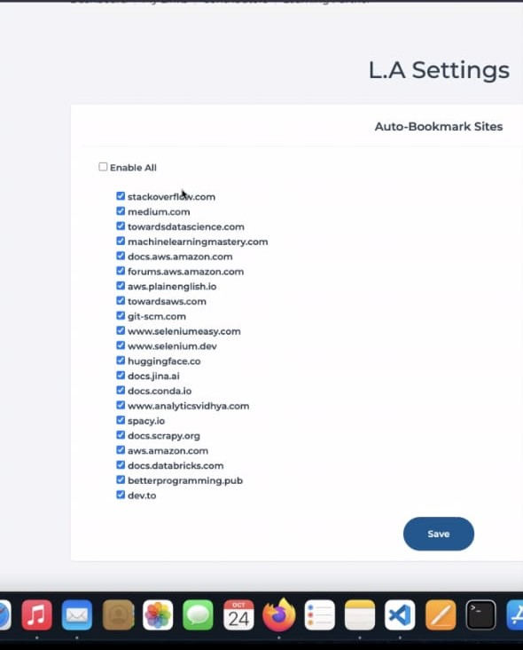
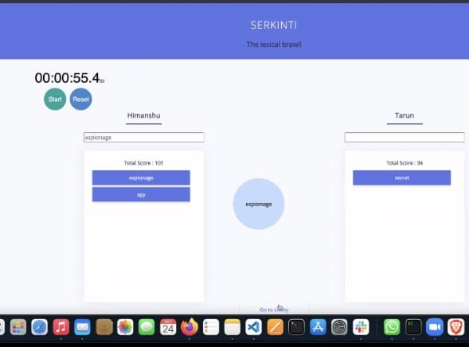
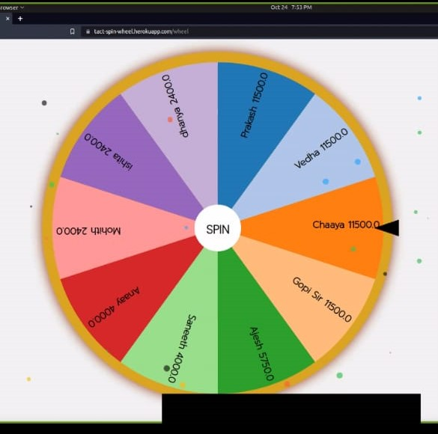
Sneak peek

Slide 12

Check out my project:-
bit.ly/himanshujina

Slide 13

Thank You!
Thanks Jina ai and featurepreneur for this wonderful opportunity. I would try to continue my learnings with same spirit.

